Slide 1
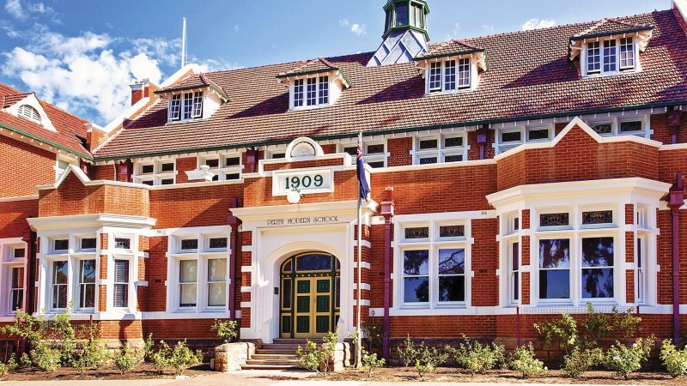
Reworking the Student Notices
By Ajay Bisnath

Slide 2
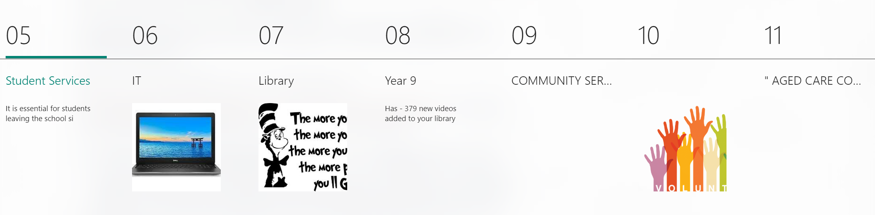
Issues with the Current System
Inconvenient and hard to read
No clear way to know when information is updated
Negative reputation
Difficult to find relevant information
Notes:
It is hard to find relevant information. The ‘subsections’ and ‘jump to’ feature are terrible due to the notices being properly broken down into sections, images providing no context and you are still unable to properly find important information.
The student notices are ugly and not user friendly. Questionable fonts are used, text is small and in long, hard to read blocks. Subsections are not emphasized well due to only using small lines and small subtitles and larger titles are in all caps which is hard to read. People aren’t going to have the attention span to read through the notices if its made up of chunks and chunks of hard to read text.
There is no way to know when the notices are updated and when new information is released. Its easy to miss a competition or opportunity because you didn’t know it was there and it gets removed from the notices before you can see it. In the current system we have to constantly be checking the notices every day to make sure we don’t miss anything.
I also know that most people get a redundant email every day for a student notices link even though the link doesn’t change. This is really pointless and we should just stop this one time and have a permanent link access in compass. People should really be saving the link as a bookmark and the email doesn’t signify any update to the notices.
The notices also have a pretty bad reputation. People are probably not going to use it even if we make some small positive changes. This is why, as you’ll see later, we’ll need to progressively work on this as a long-term project with multiple stages and we must have some large and noticeable changes to the notices to highlight that we actually have improved the notices.

Slide 3

Compass
Notes:
Now I do want to address that compass could potentially be used or is already solving some issues in the current system. However I am not very experienced with compass and we can definitely take a look at how we can use it in the future. I haven’t spoken about it in this presentation because I’m not familiar with it, who knows maybe everything I just said is invalid and Compass is not useful in anyway.

Slide 4
Provide information relevant to the whole school or a wide range of students
- Events, competitions and opportunities
- School news and updates
Information for specific year groups
Miscellaneous uses (Library uses it for overdue books)
- What is the notices currently used for?
- What could the notices be used for?
Purpose of the Student Notices
Notes:
Before we start talking about improvements and replacements, it is important that we talk about what the purpose of the student notices are, what it needs to fulfill at a minimum level and what it could be utilised for and so on.
Currently the student notices is where information about school events/competitions/opportunities/notices (such as warning about danger in the car park). It contains information relevant to the school or a wide range of students. One important thing to note is that for information that doesn’t have a set group of students it needs to target must use the notices. For example, you might have a connect class for a band because you have that set of students that you know are interested in that information, but for a math competition, anyone could potentially be interested and so you need that information to reach a wide set of students.
There is also the specific year group sections although I think these are run poorly. This is because information is so infrequent in those sections and is so underutilised. The last time the Year 10 section was used last year was Tomorrow Man/Woman schedule. Its just used for year based activities when we could use it for year based surveys, ideas, resources and just to have a better way to convey information from us to our year group.
Now does anyone have any other things that the notices should aim to fulfill?
We need to make sure that we hit all these requirements with any future systems we plan to implement.

Slide 5
Our Noticeboard
Plans for physical noticeboard
Maintenance
Touch up of the board
What to display?
Our space in the student notices
How do we get access?
How will it be maintained?
Notes:
Now we do also need to talk about our physical noticeboard in Andrews. It definitely needs to be overhauled and we need to decide what we will put on the board, how frequently we will update it and who will be responsible for maintaining the board and creating whatever we want to put on the board. With the overhaul, we will need to design how we want the board to look, it needs to be eye-catching, make use of the space and be easy to see from a distance.
We do need a digital space in the notices despite the physical noticeboard as not everyone is going to have access or check that board and it is more difficult to create something physical for the board as opposed to just putting something on the student notices.
That also brings about who do we need to contact to gain access to the notices to set up our own space, or do we need to send updated information to whoever is in charge for them to put up on the notices.

Slide 6
Plan for the Future
Improving the Current System
Designing an improvement
Implementing the new system

